Slide 1
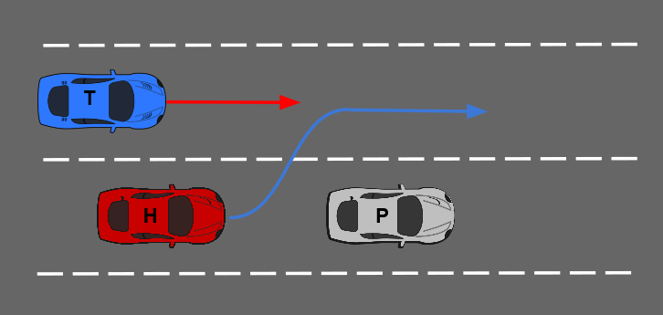
Optimal Overtaking for Autonomous Vehicles
Purpose
Cars often find themselves behind slower moving vehicles such as trucks on the highway. In these situations, they must make the decision to either overtake or trail the leading vehicle, weighing both decisions to make a safe, yet optimal manoeuvre.
Method
An optimal overtaking manoeuvre is developed in [1].
On similar lines, a model-predictive control problem over a fixed space horizon is solved to yield an optimal trailing manoeuvre.
Thereafter, at each instant, the overtaking and following manoeuvres are evaluated against each other
This is done using an objective function that takes into account the kinematics of the manoeuvre, the deviation from the reference speed and the decision robustness.
Notes:
<number>

